Slide 1
Holy Land Pilgrimage
Holy Land Pilgrimage
Psalm 122:6
Pray for the peace of Jerusalem: they shall prosper that love you.
Psalm 122:6
Pray for the peace of Jerusalem: they shall prosper that love you.

Slide 2
Day 1 & 2:
USA to Tel Aviv, Israel

Slide 3
Day 3: The Galilee
Highlights:
Boat Ride on the Sea
Mount of Beatitudes

Slide 4
Day 4: Early Life of Jesus
Highlights:
Nazareth
Cana
Caesarea

Slide 5
Day 5: The Wilderness Experience
Highlights:
Jericho
Qumran

Slide 6
Day 6: The Kings of Israel
Highlights:
Bethlehem
Garden of Gethsemane
Caiaphas’ House
The Upper Room

Slide 7
Day 7: The Old City
Highlights:
Western Wall
Via Dolorosa
Church of the Holy Sepulchre
The Upper Room

Slide 8
Day 8: Leisure Day
Highlights:
Masada/Dead Sea Option

Slide 9
Day 9: The Week that
Shook the World
Highlights:
Yad Vashem
The Garden Tomb

Slide 10
Day 10: Return Home
You will never be the same

Slide 11
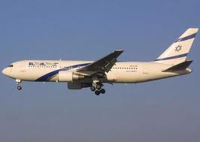
Flight Information
Flights will be given 60 to 30 days prior to departure.
Flight are typically from JFK, IAD, EWR or PHL to Tel Aviv.
1 Carry on bag and 1 checked in bag is allowed
50 Pounds
76 Linear Inches (L+W+H)
Typical carriers:
EL Al
United Airlines
American
Lufthansa etc.
Flight Letter will be printed and placed in your final document
This is not your flight ticket
Confirmation Number is on document
Most airlines will allow you to check in 24 hours in advance – or- check in at the airport.
Arrive at airport for international flight 3 hours in advance

Slide 12
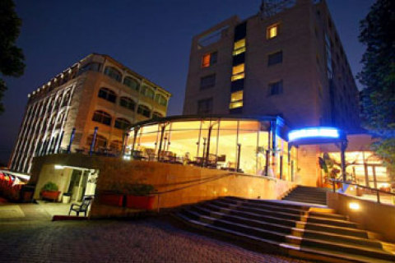
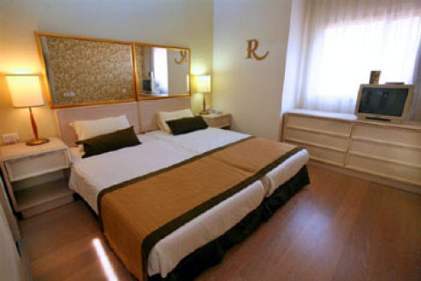
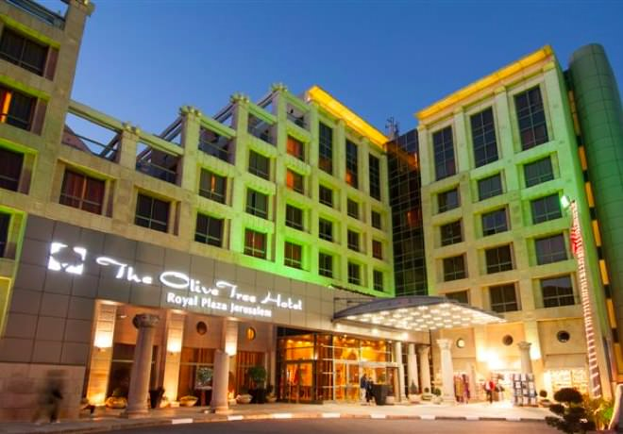
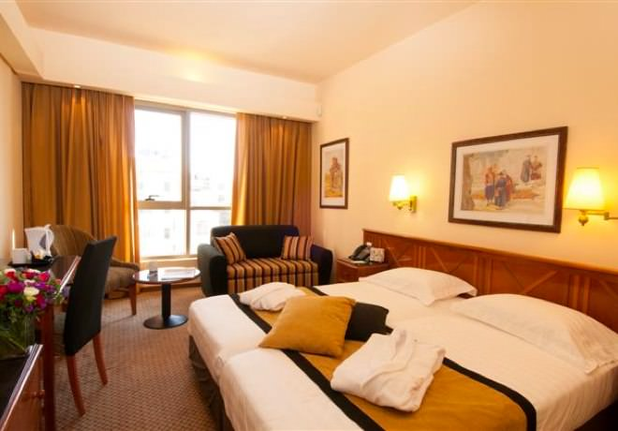
Hotels
Royal Plaza in Tiberias
Overlooking the Sea of Galilee
Fully Air Conditioned
Includes:
Hair Dryers
Two Telephones
Voicemail
Cable T.V.
Minibar
Coffee Kit
Personal Safes
Electronic Locks
**Includes Breakfast and Dinner Buffett Daily**
Olive Tree in Jerusalem
10 Minutes Walking Distance from the Old City
Fully Air Conditioned
Includes:
Hair Dryers
WiFi Internet Access for Laptops and smart phones
Cable T.V.
Minibar
Coffee Kit
Personal Safes*
Electronic Locks
**Includes Breakfast and Dinner Buffett Daily**
Will need international converter for charging cell phones etc.

Slide 13
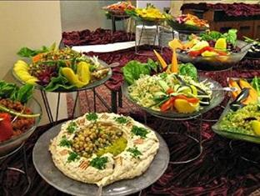
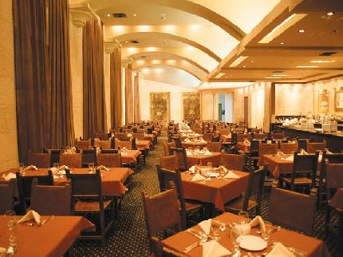
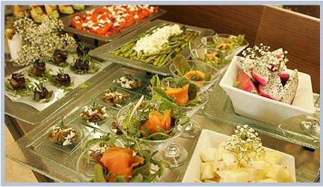
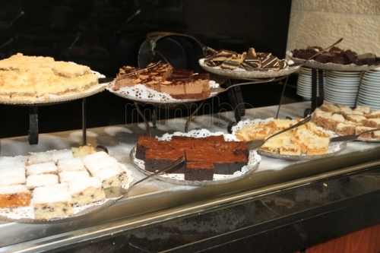
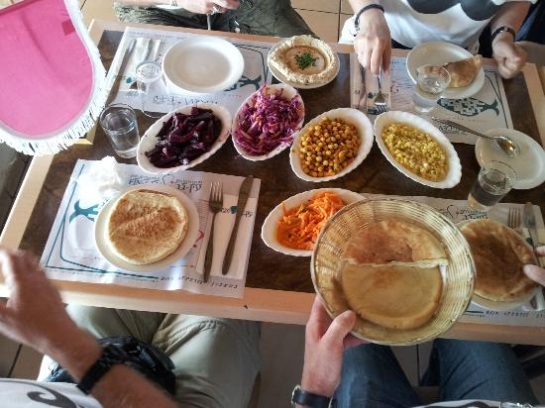
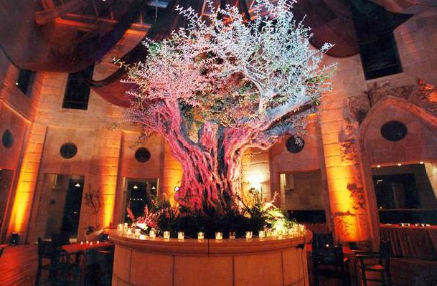
Meals Included
Breakfast and Dinner Buffett Included Daily

Slide 14
Money
Dollar is accepted everywhere (no need to exchange)
How much money should I bring?
Lunches - $10 - $15 Daily
Tips for Guide - $6 Per Person, Per Day = $48
Tips for Driver - $3 Per Person, Per Day = $24
Baptismal Site – Robe and Changing $12 - $15
Souveniers
$250 in Cash ($1 and $5 preferably)
Visa and Mastercard are Widely Accepted

Slide 15
Weather
WEATHER IN ISRAEL SUMMER Israel temperatures are usually in the high 80′s, low 90′s. Tel Aviv, and Tiberias will be hot and humid (like Miami). Jerusalem is dryer and cooler, particularly at night. Masada & Eilat are extremely hot (possibly above 110F (43C), but dry. Not a drop of rain.

Slide 16
Light weight and loose fitting clothing Comfortable walking shoes, sneakers and sandals Skirts/Dresses /Shorts (below the knee length for Shabbat and the Western Wall) Bathing suit, water shoes and towel (Dead Sea & Jordan River) Pajamas Undergarments Important: During the Summer the sun is most intense. Hat for the sun Sunscreen Sunglasses Long shorts, skirts and even long-sleeved shirts will help you stay protected
Clothing

Slide 17
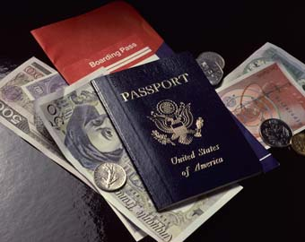
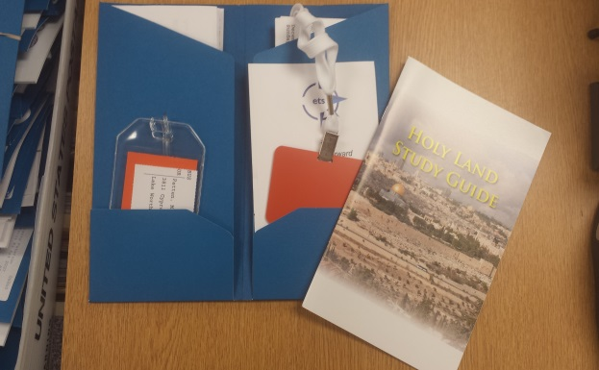
Travel Documents
Bring Your Passport
Must not expire until 6 months after return date
Visas are included
Final Documents will arrive 2 – 3 weeks prior.
Include:
Name Tag
Luggage Tag
Study Guide
Itinerary (Addresses and #)
Flight Letter
Medical Form
Things to know before you go

Slide 18
The Trip of a Lifetime
Walk Where Jesus Walked
Bring the Bible to Life
Come back with a new
Understanding of our Lord

